Slide 1
16S Sequencing
Nick Loman
Thanks:
Mike Cox
Rob Knight

Slide 2
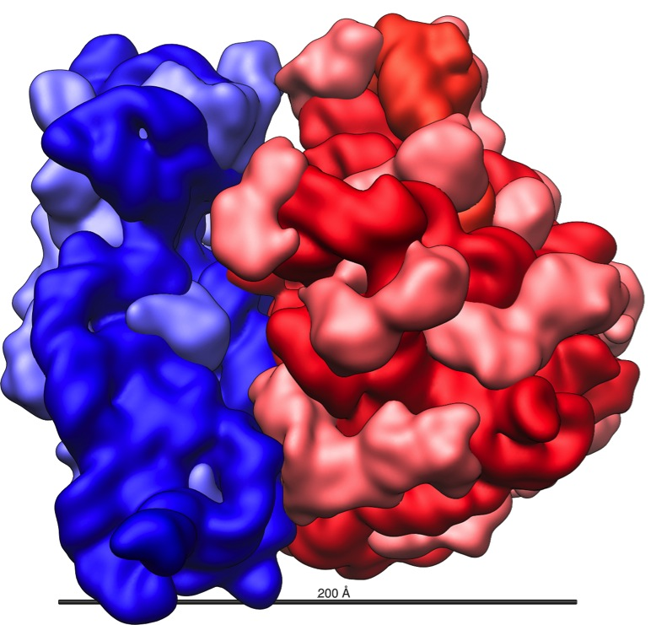
16S Ribosomal
Subunit
Carl Woese
Phylogenetic structure of the prokaryotic domain: the primary kingdoms
Woese and Fox, 1977 PNAS 74(11) pp 5088-5090
Norman Pace:
Rapid determination of 16S ribosomal RNA sequences for phylogenetic analyses
Lane et al, 1985 PNAS 82(20) pp 6955-6959
Notes:
Like the large (23S) ribosomal RNA, it has a structural role, acting as a scaffold defining the positions of the ribosomal proteins.
The 3' end contains the anti-Shine-Dalgarno sequence, which binds upstream to the AUG start codon on the mRNA. The 3'-end of 16S RNA binds to the proteins S1 and S21 known to be involved in initiation of protein synthesis; RNA-protein cross-linking by A.P. Czernilofsky et al. (FEBS Lett. Vol 58, pp 281–284, 1975).
Interacts with 23S, aiding in the binding of the two ribosomal subunits (50S+30S)
Stabilizes correct codon-anticodon pairing in the A site, via a hydrogen bond formation between the N1 atom of Adenine (see image of Purine chemical structure) residues 1492 and 1493 and the 2'OH group of the mRNA backbone

Slide 3
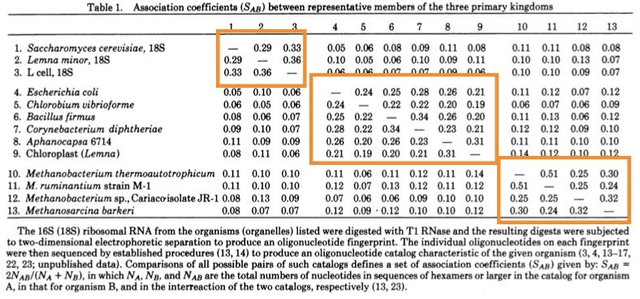

Slide 4
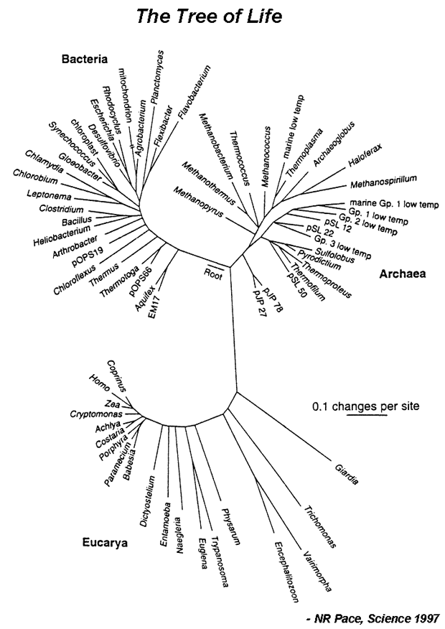
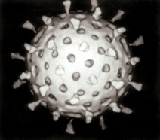
+ Viruses

Slide 5
+ Viruses

Slide 6
+ Viruses
All organisms are microbial - big things are aberrations

Slide 7
Pseudomonas aeruginosa
+ Viruses
Staphylococcus aureus

Slide 8
+ Viruses
You Are Here

Slide 9
+ Viruses
You Are Here
So is Corn on the Cob

Slide 10
+ Viruses
You Are Here
You are more like a vegetable than
Pseudomonas aeruginosa is like Staphylococcus aureus
So is Corn on the Cob

Slide 11
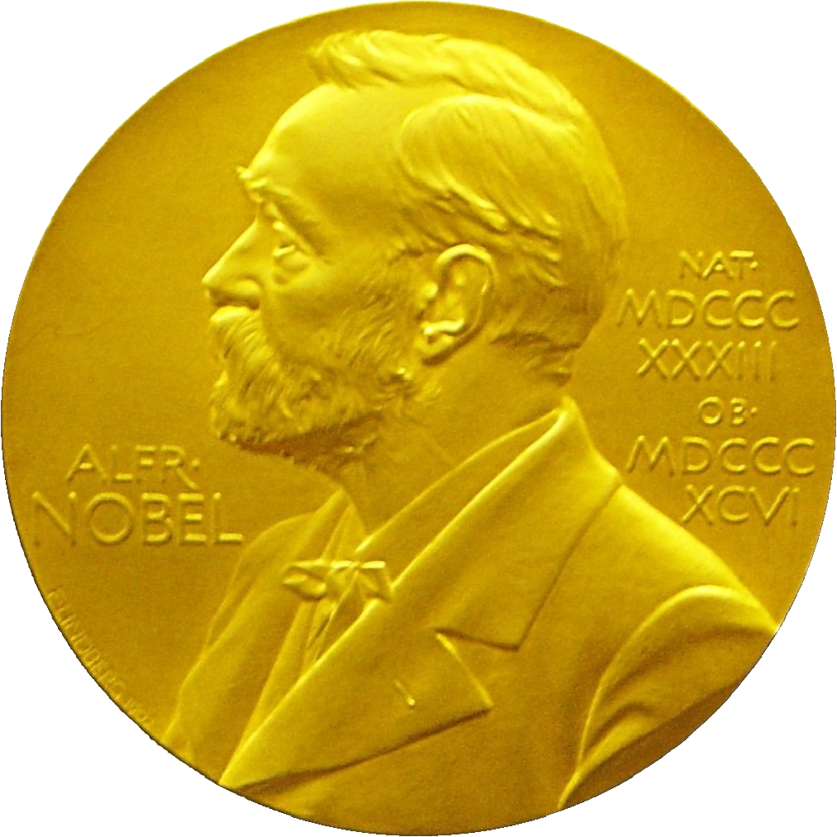
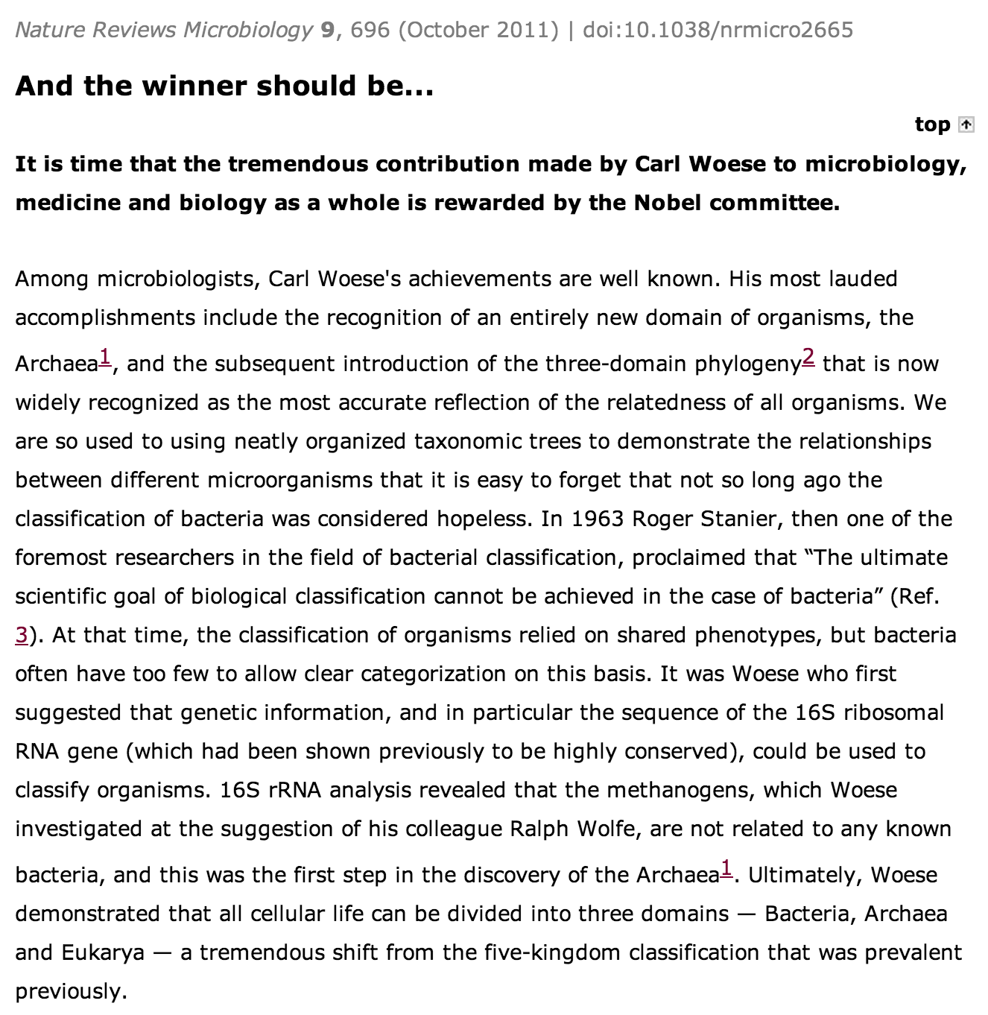

Slide 12
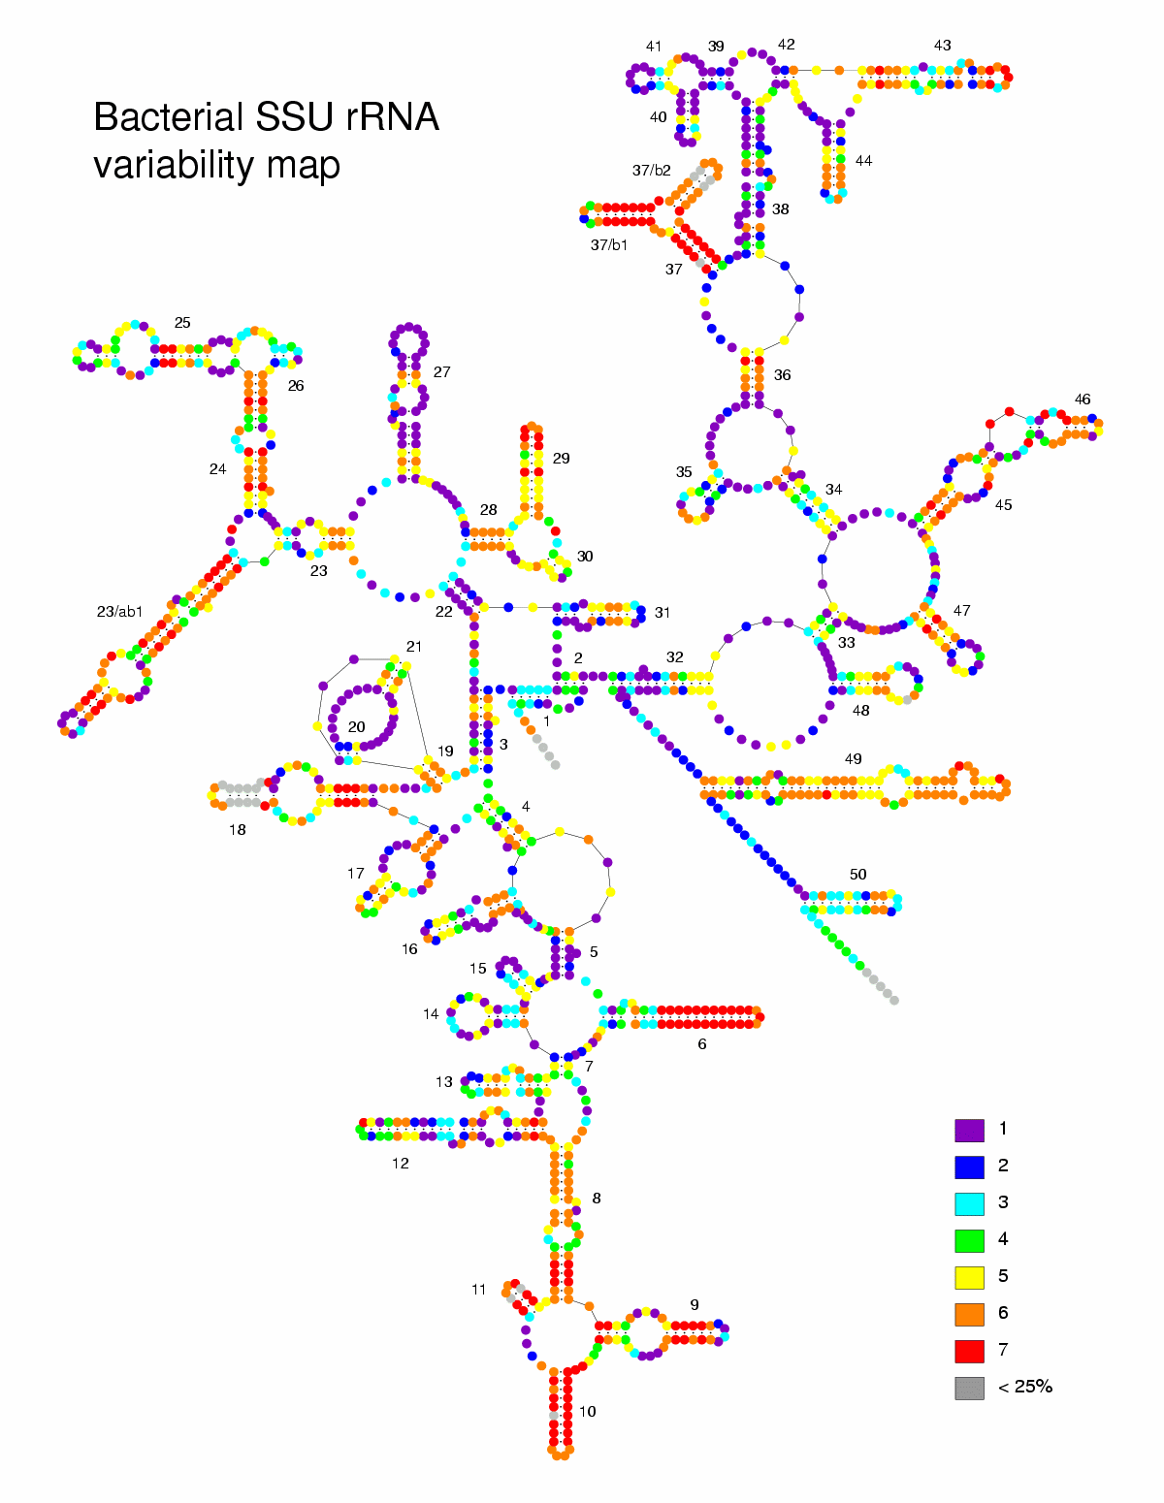

Slide 13
PCR of 16S rRNA gene
Ribosome encoding genes conserved
House-keeping genes
Present in every cellular organism
Conserved regions
Variable regions
16S rRNA gene (SSU rRNA or rrnA) reasonable length for sequencing

Slide 14
V3
V4
5
Take advantage of conserved and variable regions of a highly conserved gene. Conserved regions allow universal primer design. Variable regions allow identification of the organism
Primer
Barcode
Tag
Adaptor B
Adaptor A
Tag
Primer
Couple this with high-throughput sequencing e.g. Roche 454 pyrosequencing and you can rapidly determine which bacteria are present in multiple samples and how abundant they are.

Slide 15
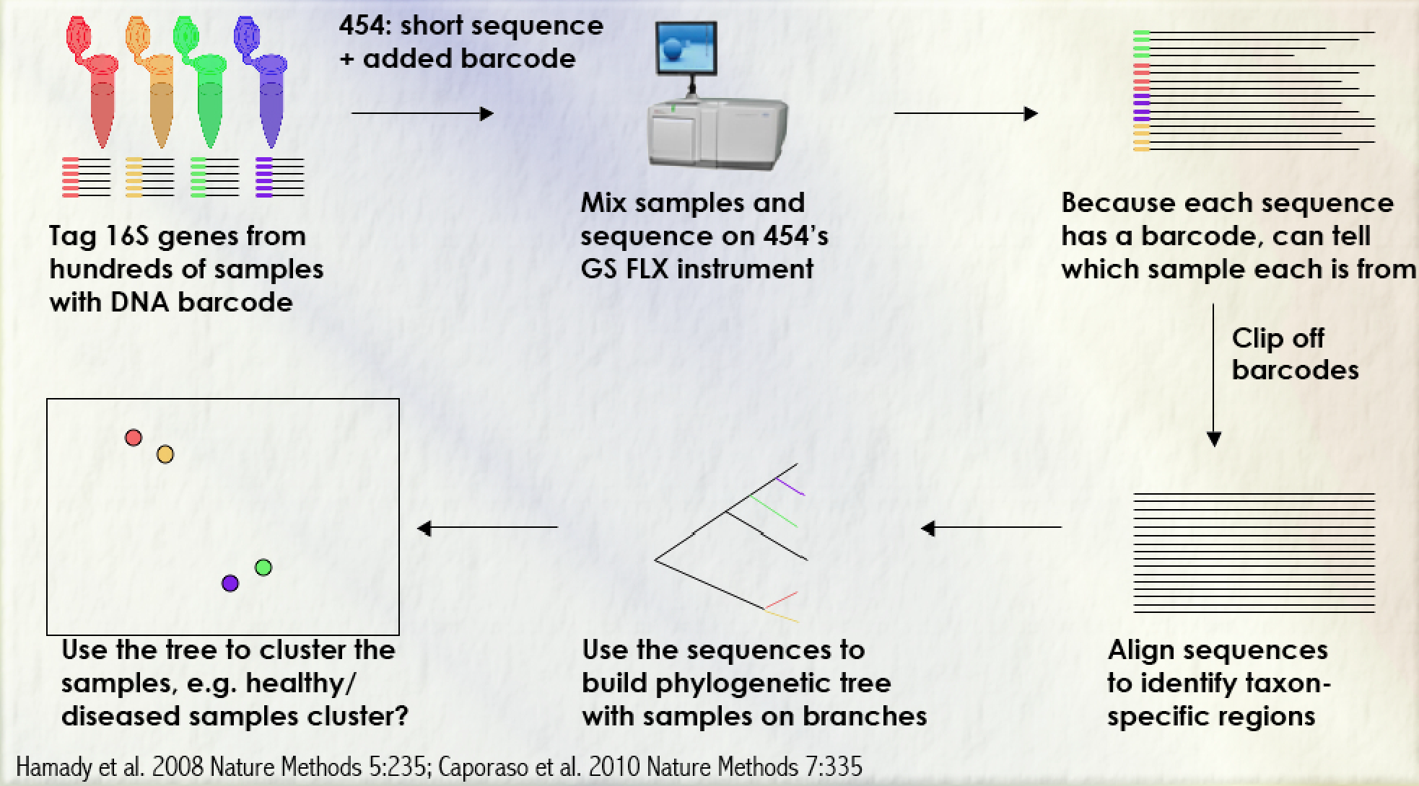
Practical 16S sequencing

Slide 16
16S vs metagenomics
Cheap
Targets single marker gene
Limited to bacteria
Relatively easy to analyse
Lots of known biases
Taxonomic assignment at species level problematic
Function can only be inferred, not detected
Goes deeper
Expensive
In theory can detect anything
Harder to analyse
Fewer biases (?)
Function information directly accessible
Strain-level information
Shallower

Slide 17
Microbiome = All the microorganisms in an environment and their interactions between each other and with that environment Microbiota = All the microorganisms in an environment

Slide 18
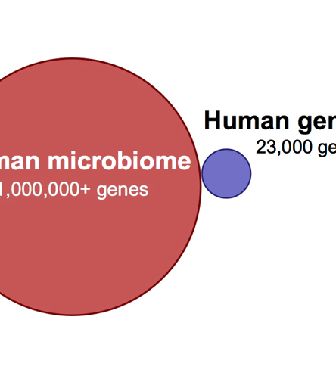
Human Microbiome
Incredibly diverse
Viruses, Phage, Bacteria, Archaea, Fungi etc.
Specific to host niche
Enormous metabolic and genetic potential
>100 x genes in human genome
Unique to the individual
More similar in twins and families, but not identical

Slide 19
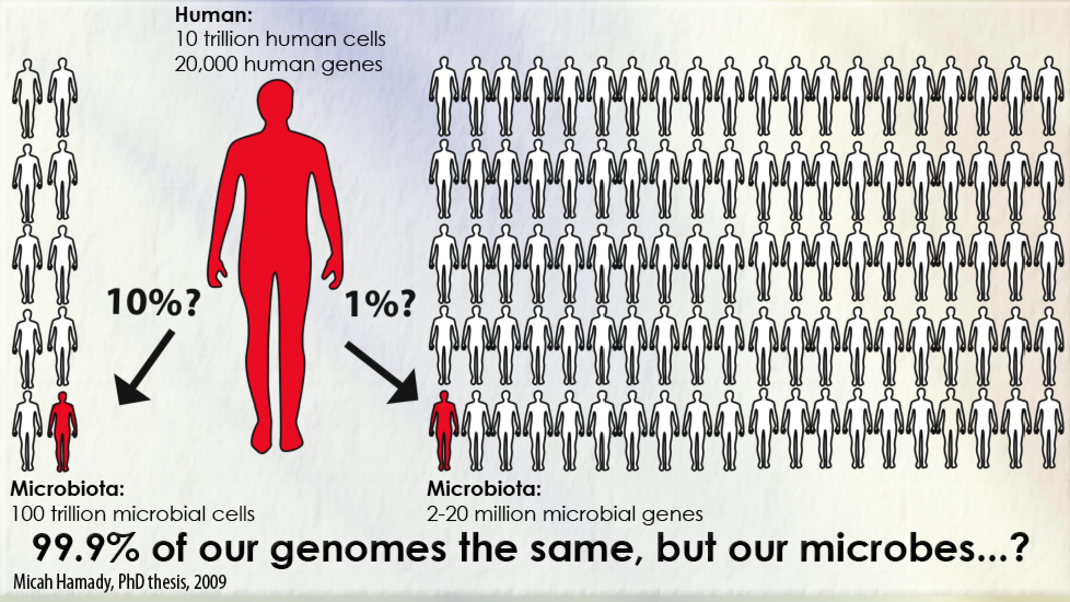

Slide 20

Notes:
For up to two weeks can identify which finger from an individual has pressed which key on a keyboard. Unique.

Slide 21
Notes:
For up to two weeks can identify which finger from an individual has pressed which key on a keyboard. Unique.

Slide 22
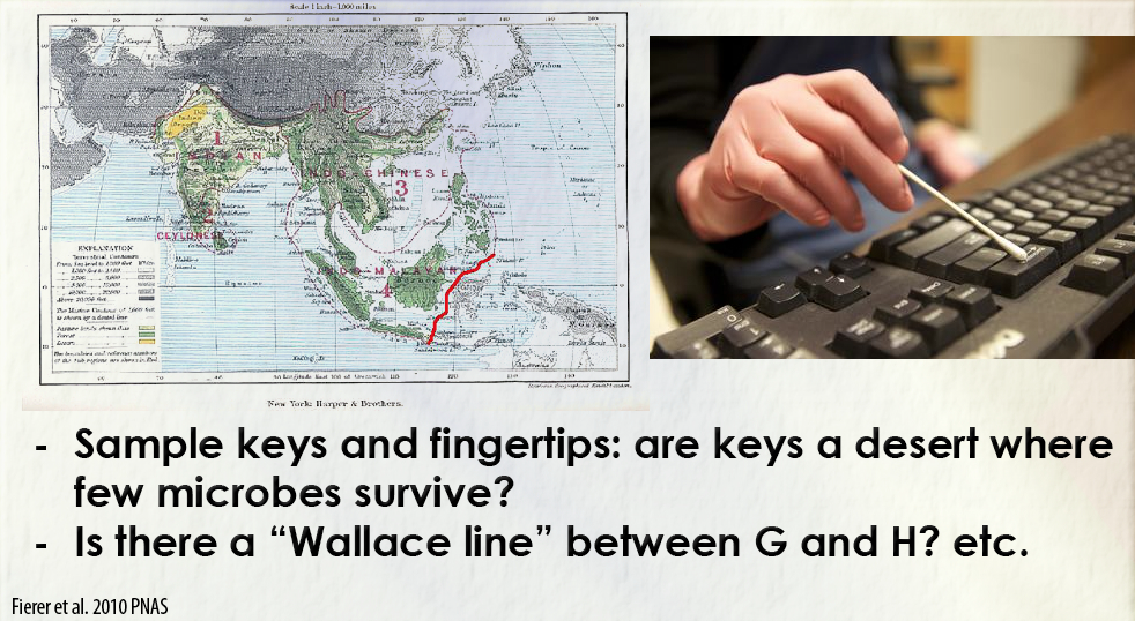

Slide 23
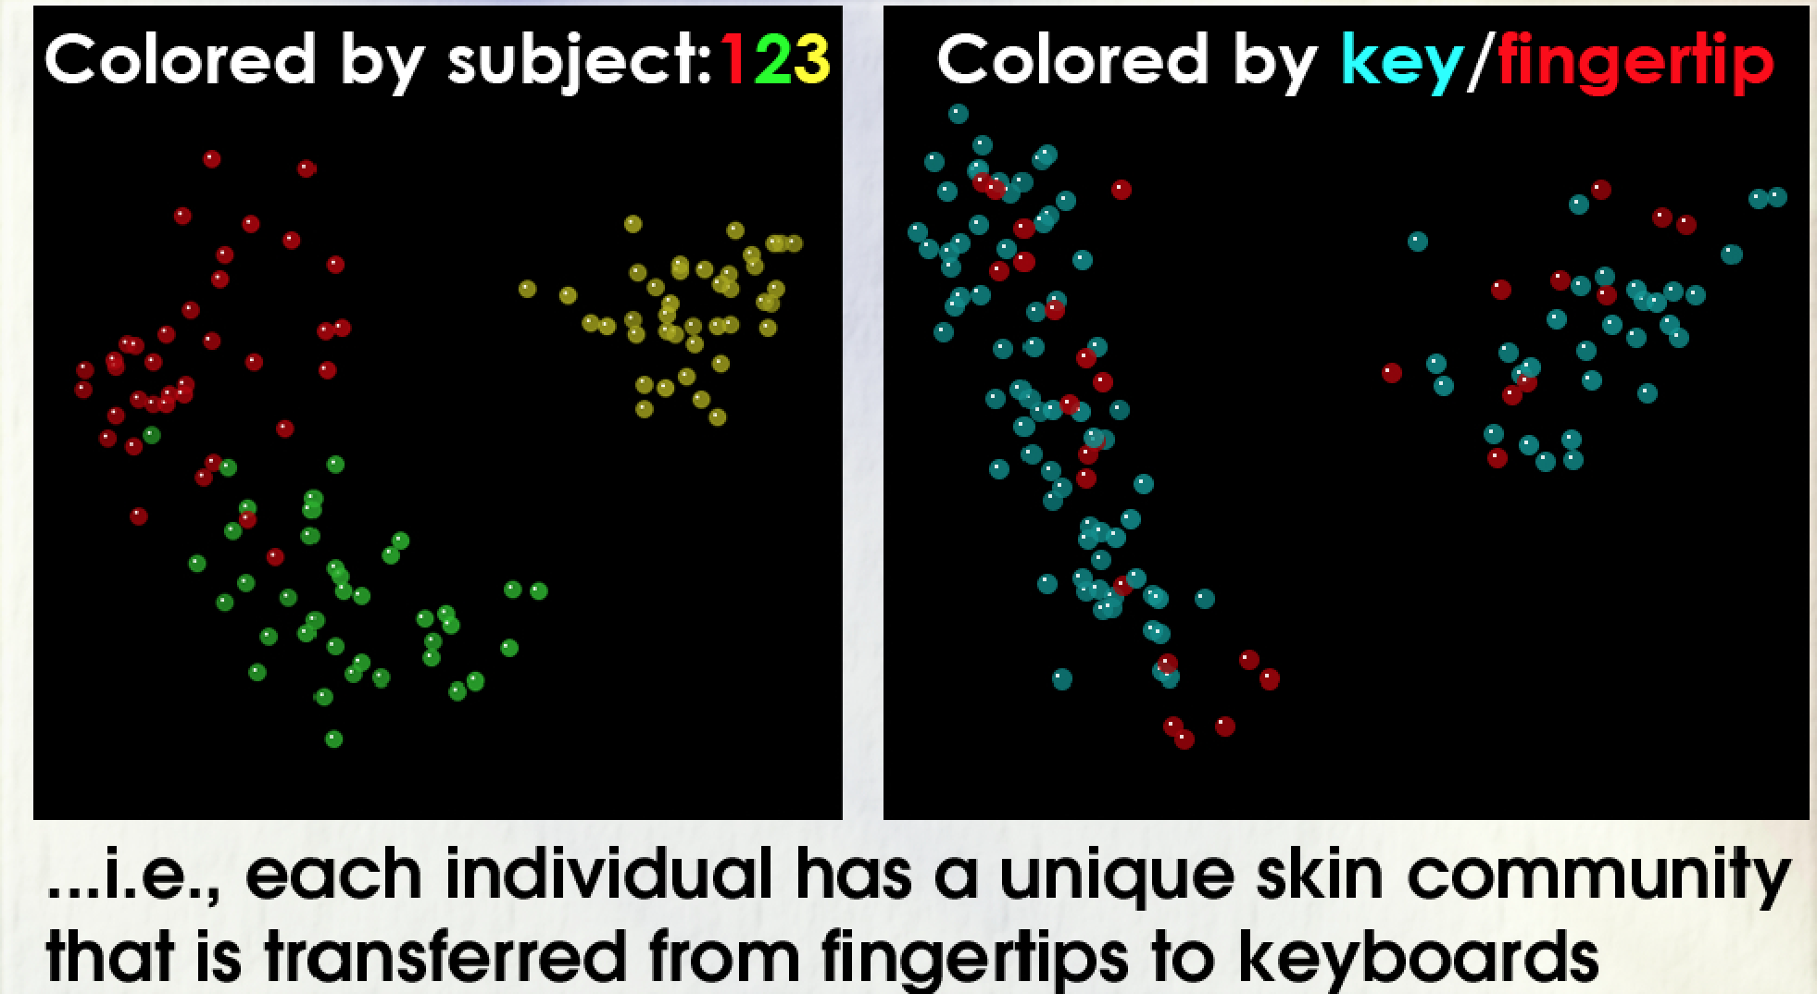

Slide 24
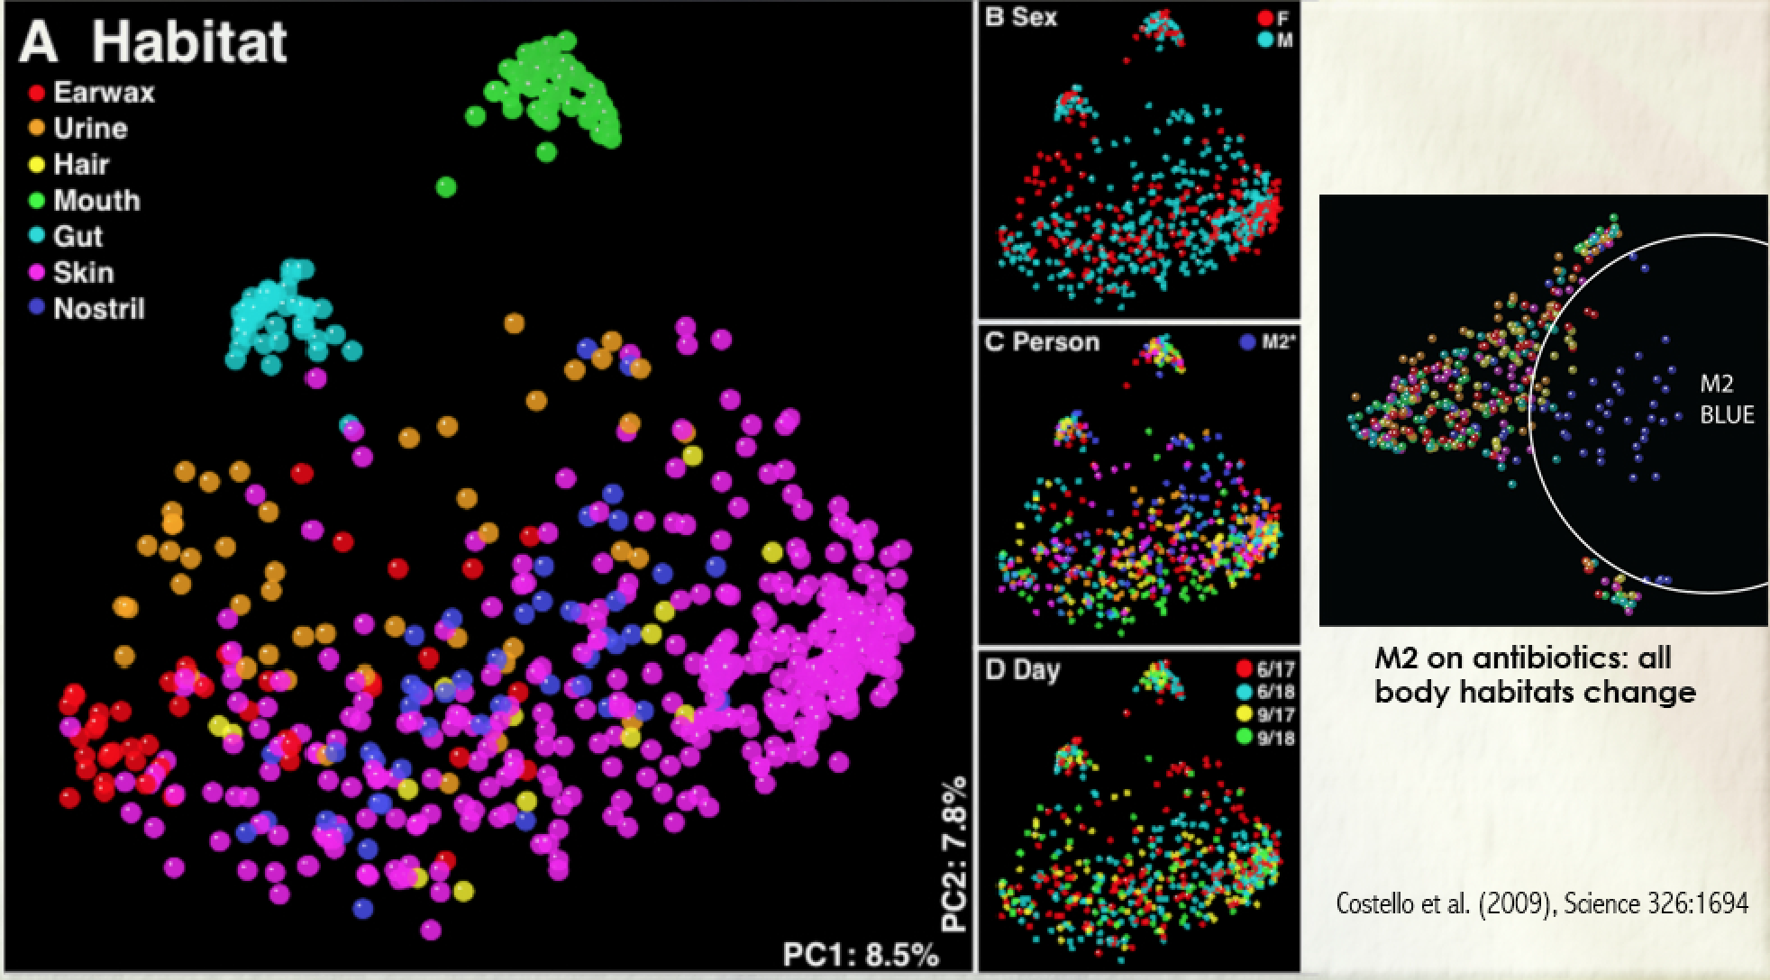
Different body habitats are very different from each other

Slide 25
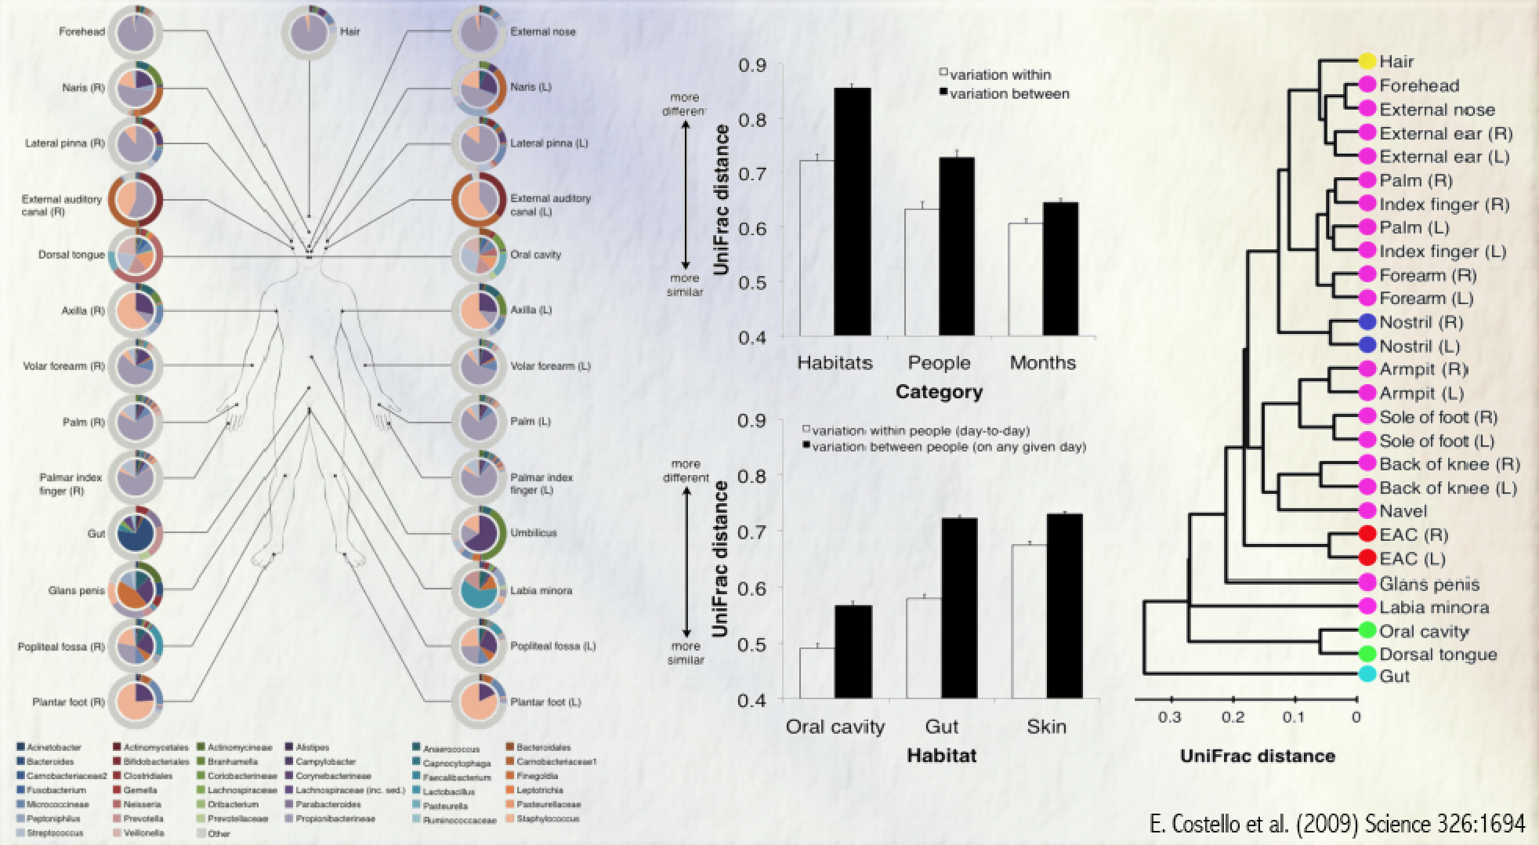
Getting picture of overall variability

Slide 26
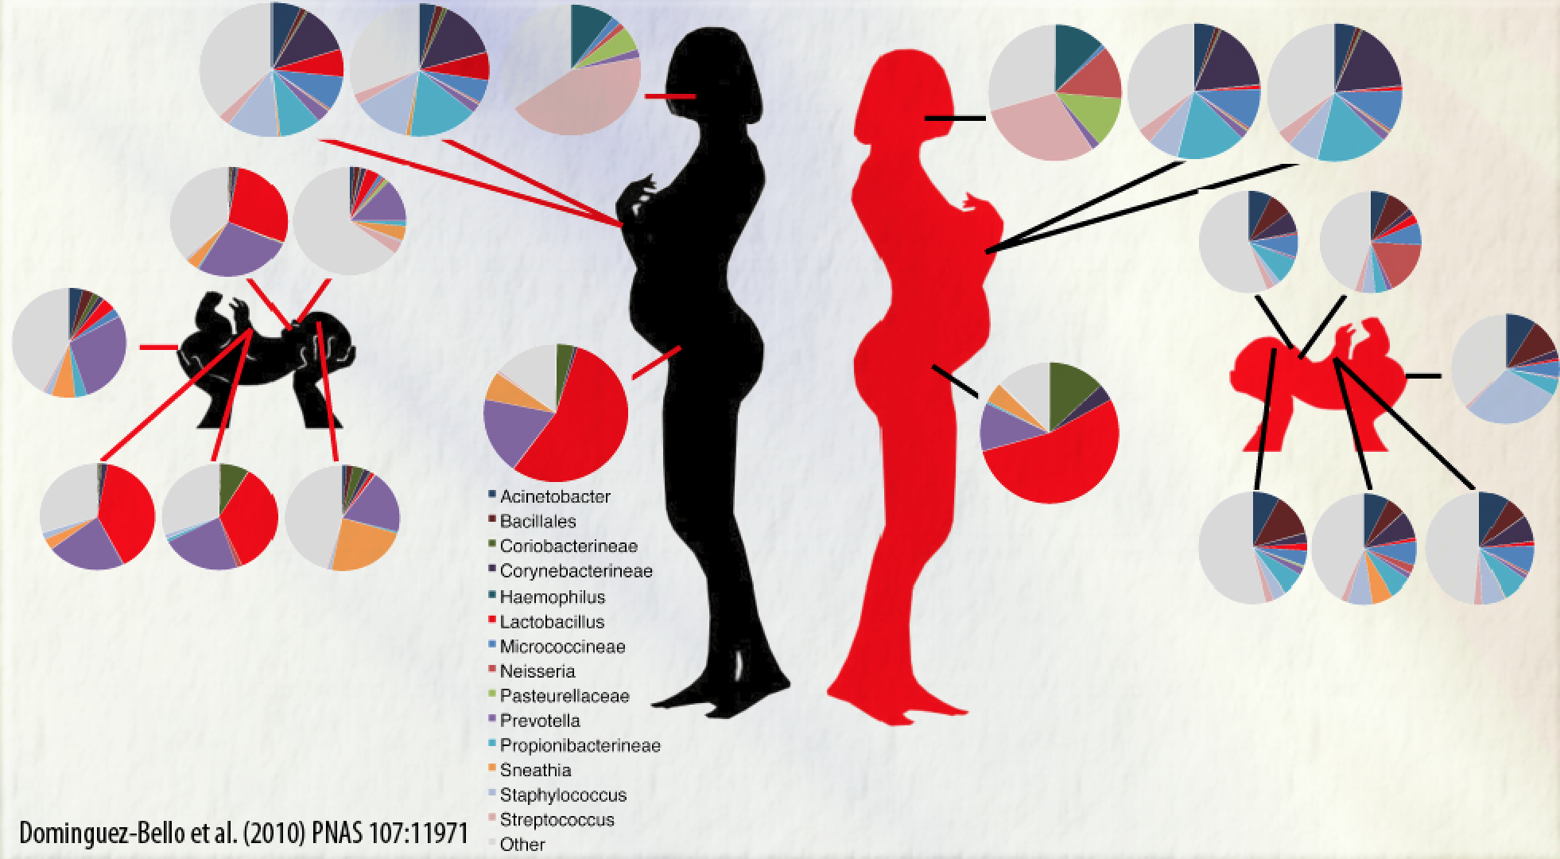
Where does your microbiome come from?

Slide 27
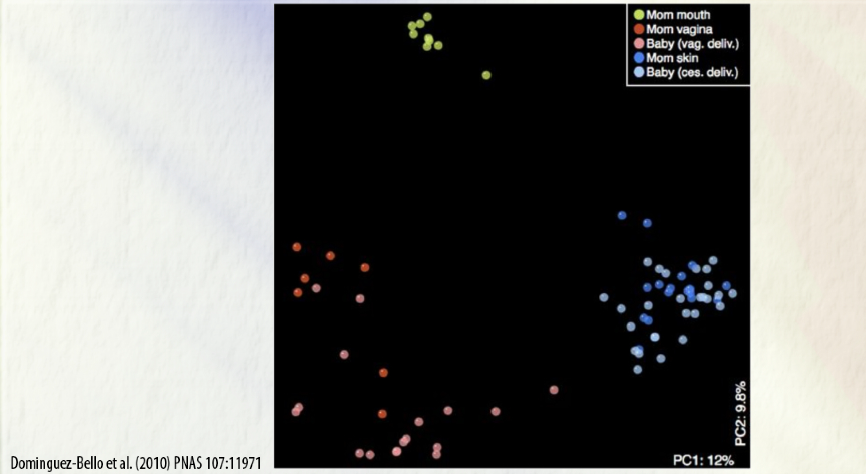
The microbiota after birth, alternative view

Slide 28
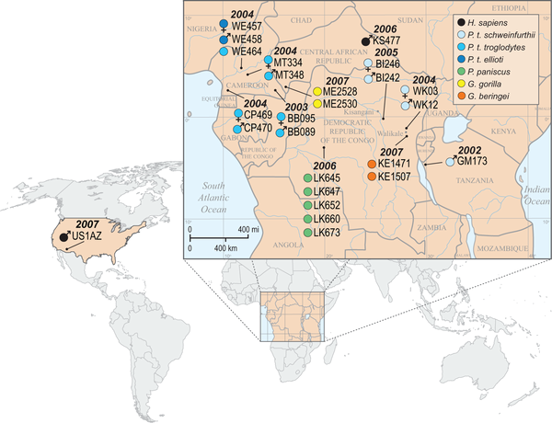

Figure 1. Sample key, locations, collection dates, gender, and taxonomic classification of great apes whose gut microbiotae were analyzed.
Ochman H, Worobey M, Kuo C-H, Ndjango J-BN, et al. (2010) Evolutionary Relationships of Wild Hominids Recapitulated by Gut Microbial Communities. PLoS Biol 8(11): e1000546. doi:10.1371/journal.pbio.1000546
http://www.plosbiology.org/article/info:doi/10.1371/journal.pbio.1000546

Slide 29
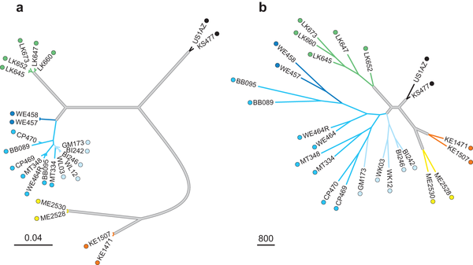
Figure 3. Phylogeny of great apes based on mtDNA sequence variation and composition of host gut microbiota.
Ochman H, Worobey M, Kuo C-H, Ndjango J-BN, et al. (2010) Evolutionary Relationships of Wild Hominids Recapitulated by Gut Microbial Communities. PLoS Biol 8(11): e1000546. doi:10.1371/journal.pbio.1000546
http://www.plosbiology.org/article/info:doi/10.1371/journal.pbio.1000546

Slide 30
Prove it…
What is a pathogen?
A microorganism that causes disease

Slide 31
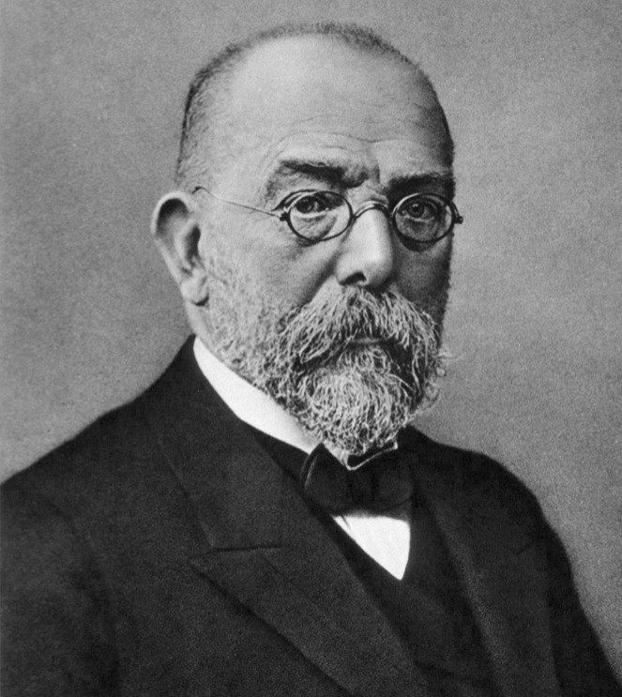
Koch’s postulates
Found in diseased individuals, not found in healthy
Isolated and grown in pure culture
Isolate causes disease in healthy individuals
If you isolate again from the test subject, should be the same organism

Slide 32
Koch’s postulates
Found in diseased individuals, not found in healthy
Isolated and grown in pure culture
Isolate causes disease in healthy individuals
If you isolate again from the test subject, should be the same organism

Slide 33
Koch’s postulates
Found in diseased individuals, not found in healthy
Isolated and grown in pure culture
Isolate causes disease in healthy individuals, usually animals
If you isolate again from the test subject, should be the same organism
Vibrio cholerae and cholera, Salmonella typhi and typhoid
May be difficult or not be possible
Animal models may not be susceptible – M.leprae
As 2. and also, how do you confirm it’s the same?

Slide 34
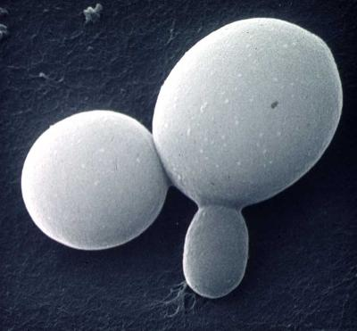
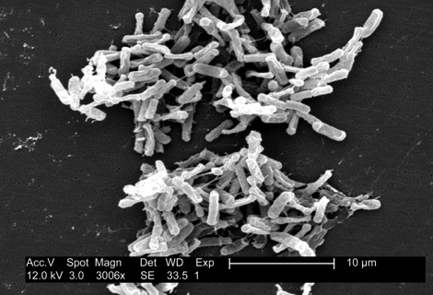
Friend or Foe?
Candida spp.
Common commensal fungus
Causes disease in the immunocompromised
Clostridium difficile
Normal low-level member of gut microbiota
Systemic antibiotic treatment causes pathogenesis

Slide 35
Pathogenicity isn’t a property possessed by any one organism An emergent property of the interactions between the host and microorganism > 99% of bacteria aren’t involved in pathogenesis

Slide 36
Beneficial bacteria
Metabolites
Vitamins K2, B12, Folic acid
Competitive exclusion
C. difficile, phage and mucin
SCFA’s
Butyrate and gut epithelium
Drug metabolism
Oestrogen processing
Pro and prebiotics?

Slide 37
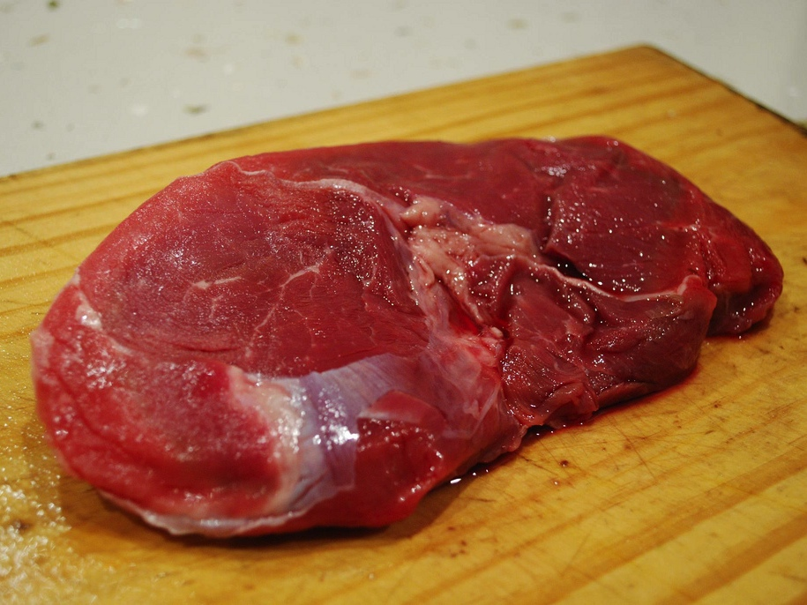
Notes:
L-carnitine to TMAO (trimethylamine-N-oxide). Disease.

Slide 38
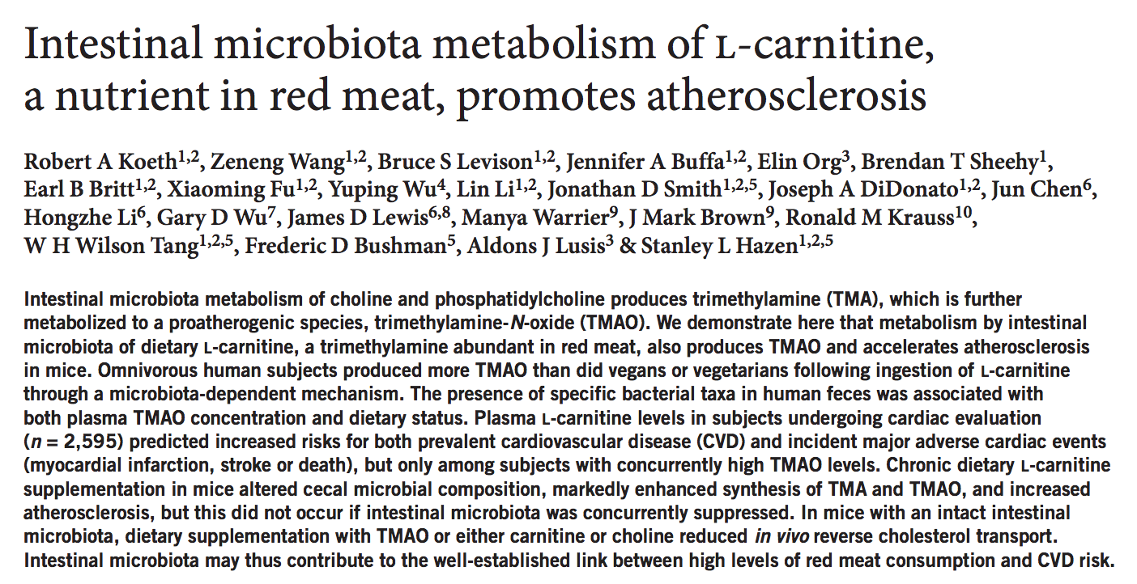
Notes:
L-carnitine to TMAO (trimethylamine-N-oxide). Disease.

Slide 39
Medicating the microbiome
Selective therapies
Antibiotics, phage therapy, vaccination
Community manipulation
Faecal transplants and probiotics, environmental change, gene therapy, ivacaftor
Novel drug targets
Quorum sensing, microbial nutrition

Slide 40
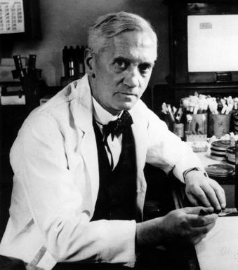
Antibiotics
Compounds produced by bacteria and fungi to control the growth of competing bacteria and fungi
Resistance mechanisms exist for every antibiotic
Resistance mechanisms can be shared easily between bacteria (they have lots of sex)
Exploited by humans and used to treat disease
Fleming

Slide 41
Antibiotics
Compounds produced by bacteria and fungi to control the growth of competing bacteria and fungi
Resistance mechanisms exist for every antibiotic
Resistance mechanisms can be shared easily between bacteria (they have lots of sex)
Exploited by humans and used to treat disease
Fleming
HOWEVER!
Used inappropriately increases selection pressure for resistance
Growth promotion
Inappropriate prescription
Not finishing courses
Organisms resistant to almost all antibiotics increasing in prevalence
XDR TB, MRSA, VRE

Slide 42
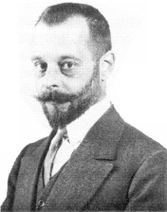
Alternatives
Phage therapy
Viruses that infect bacteria
Very specific host range, so you need a cocktail
Successfully used, but lost out to antibiotics on the research front
Salami
Vaccination
Preventative rather than a treatment
Hard to design vaccines for bacteria

Slide 43
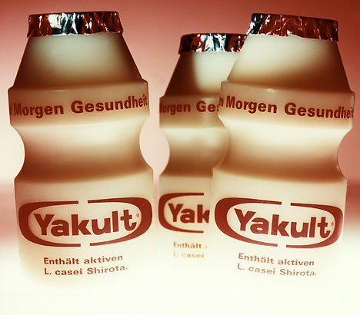
1. Lessons from ecology
Don’t kill everything, manipulate the community
Probiotics e.eg Lactobacillus casei subsp. rhamnosus strain GG

Slide 44
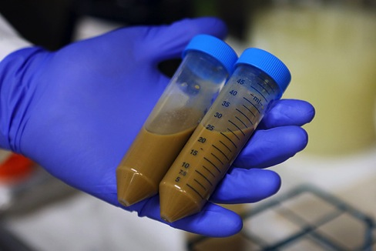
2. Lessons from ecology
Change the whole community
Faecal transplants

Slide 45
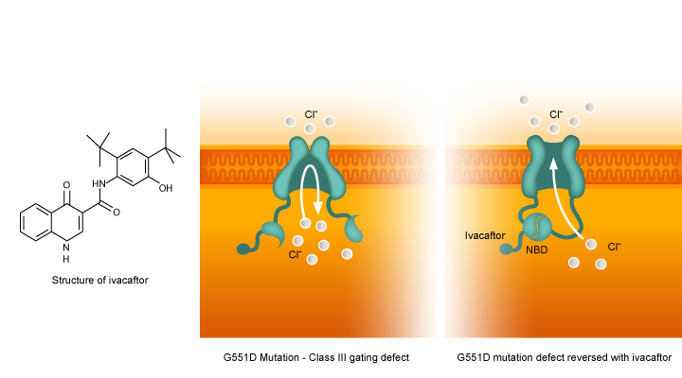
3. Lessons from ecology
The environment selects – change the environment – drug not working on the bugs directly so no resistance
Cystic fibrosis
Gene therapy
Ivacaftor

Slide 46

Sample
Take a sample
Soil, seawater, house dust, squashed bugs from a windscreen, murder scene blood splashes
Preserve
Bacteria will continue grow and compete in their new environment without preserving the sample
Extract total DNA
Some will be human, some virus, some fungal – how to tell it apart?

Slide 47
Today’s practical
Toilet cubicles
Keyboards
The human microbiome in time and space
Infant gut

Slide 48
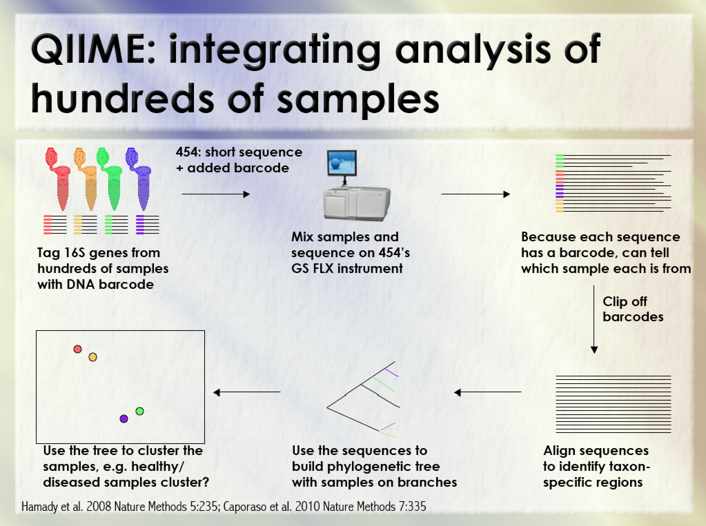

Slide 49
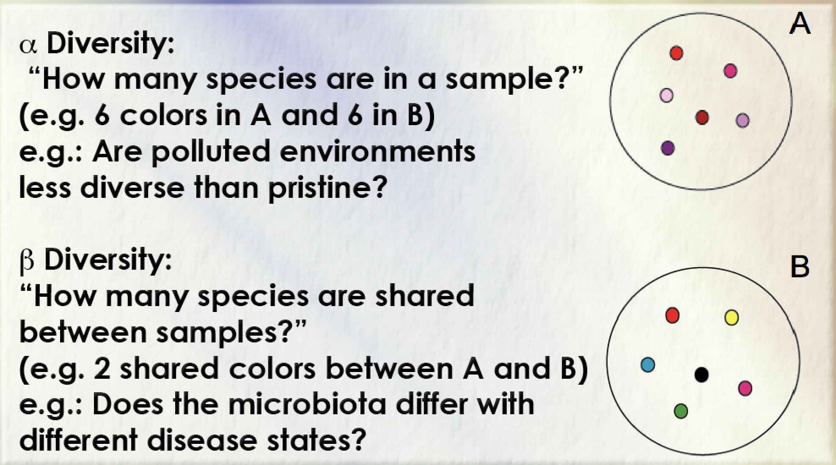
How do we compare samples?

Slide 50
Alpha diversity – the different organisms within a sample
Operational Taxonomic Units – OTUs
No consistent definition of a species for bacteria, so use 97 % DNA identity in 16S gene as a proxy

Slide 51
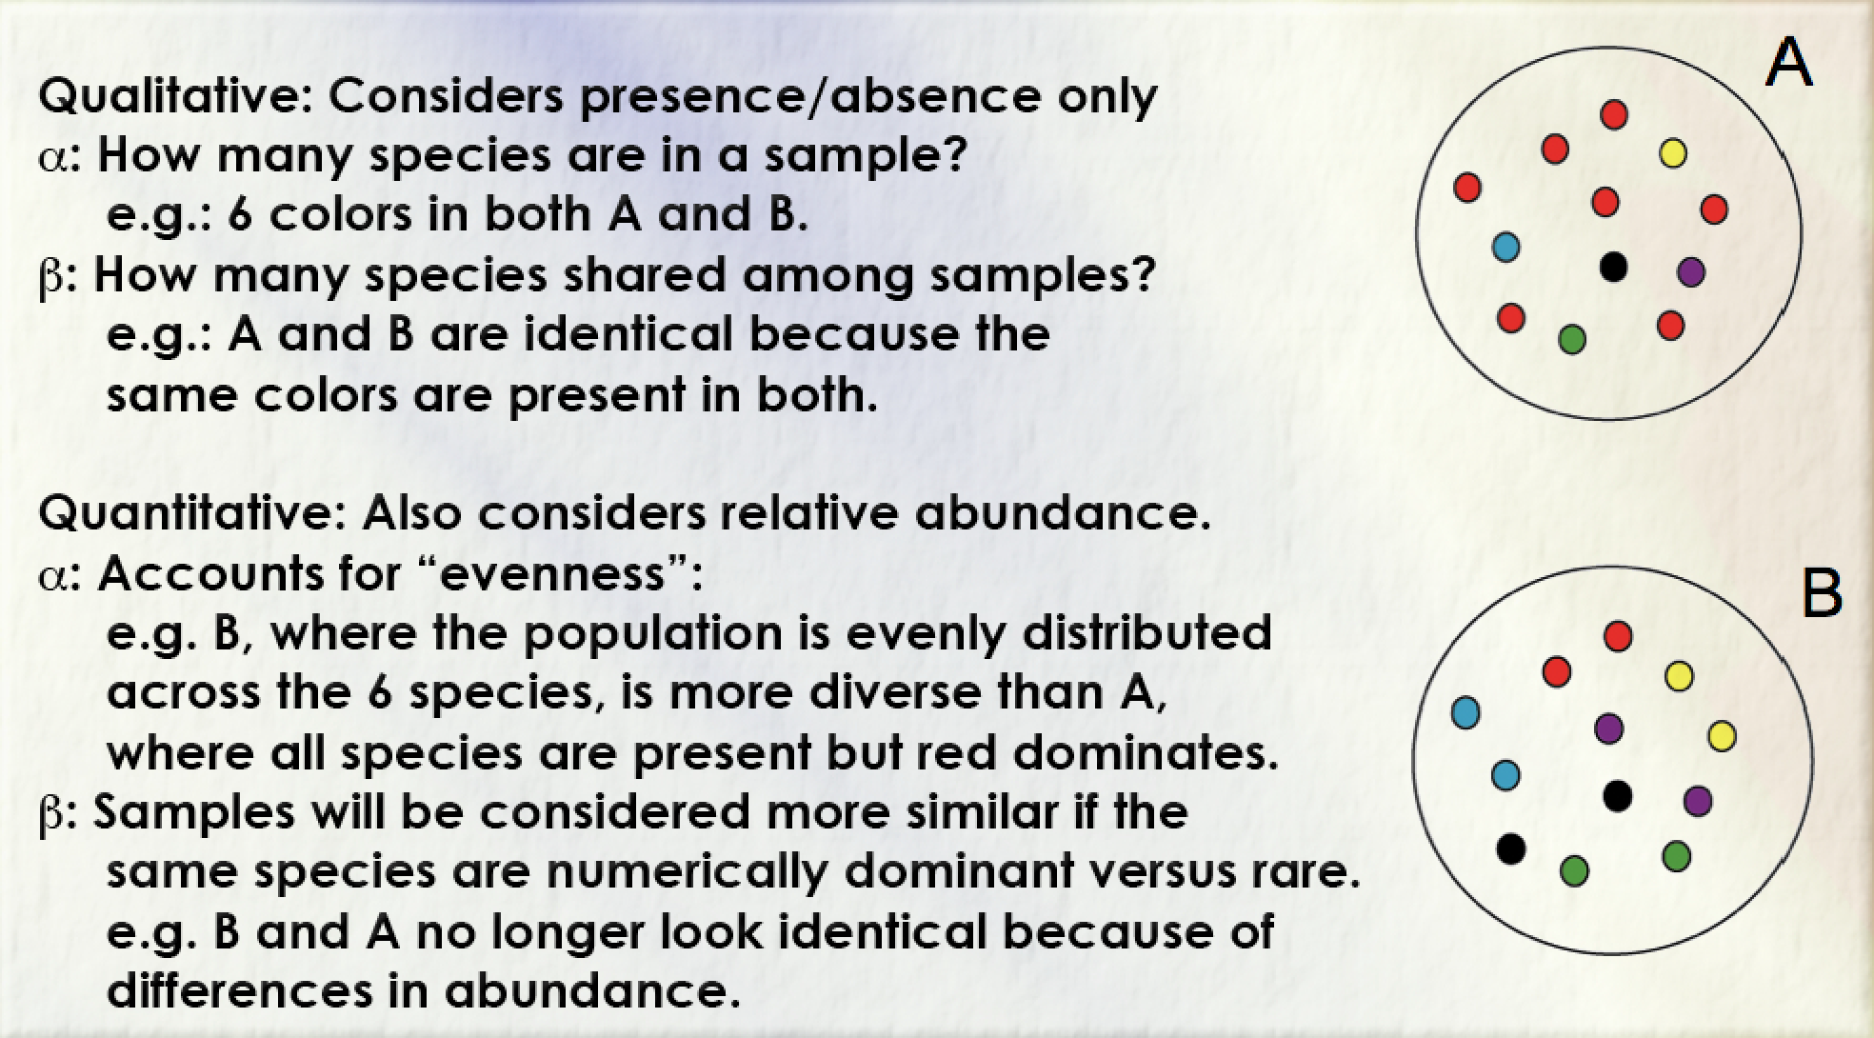
Qualitative vs quantitative

Slide 52
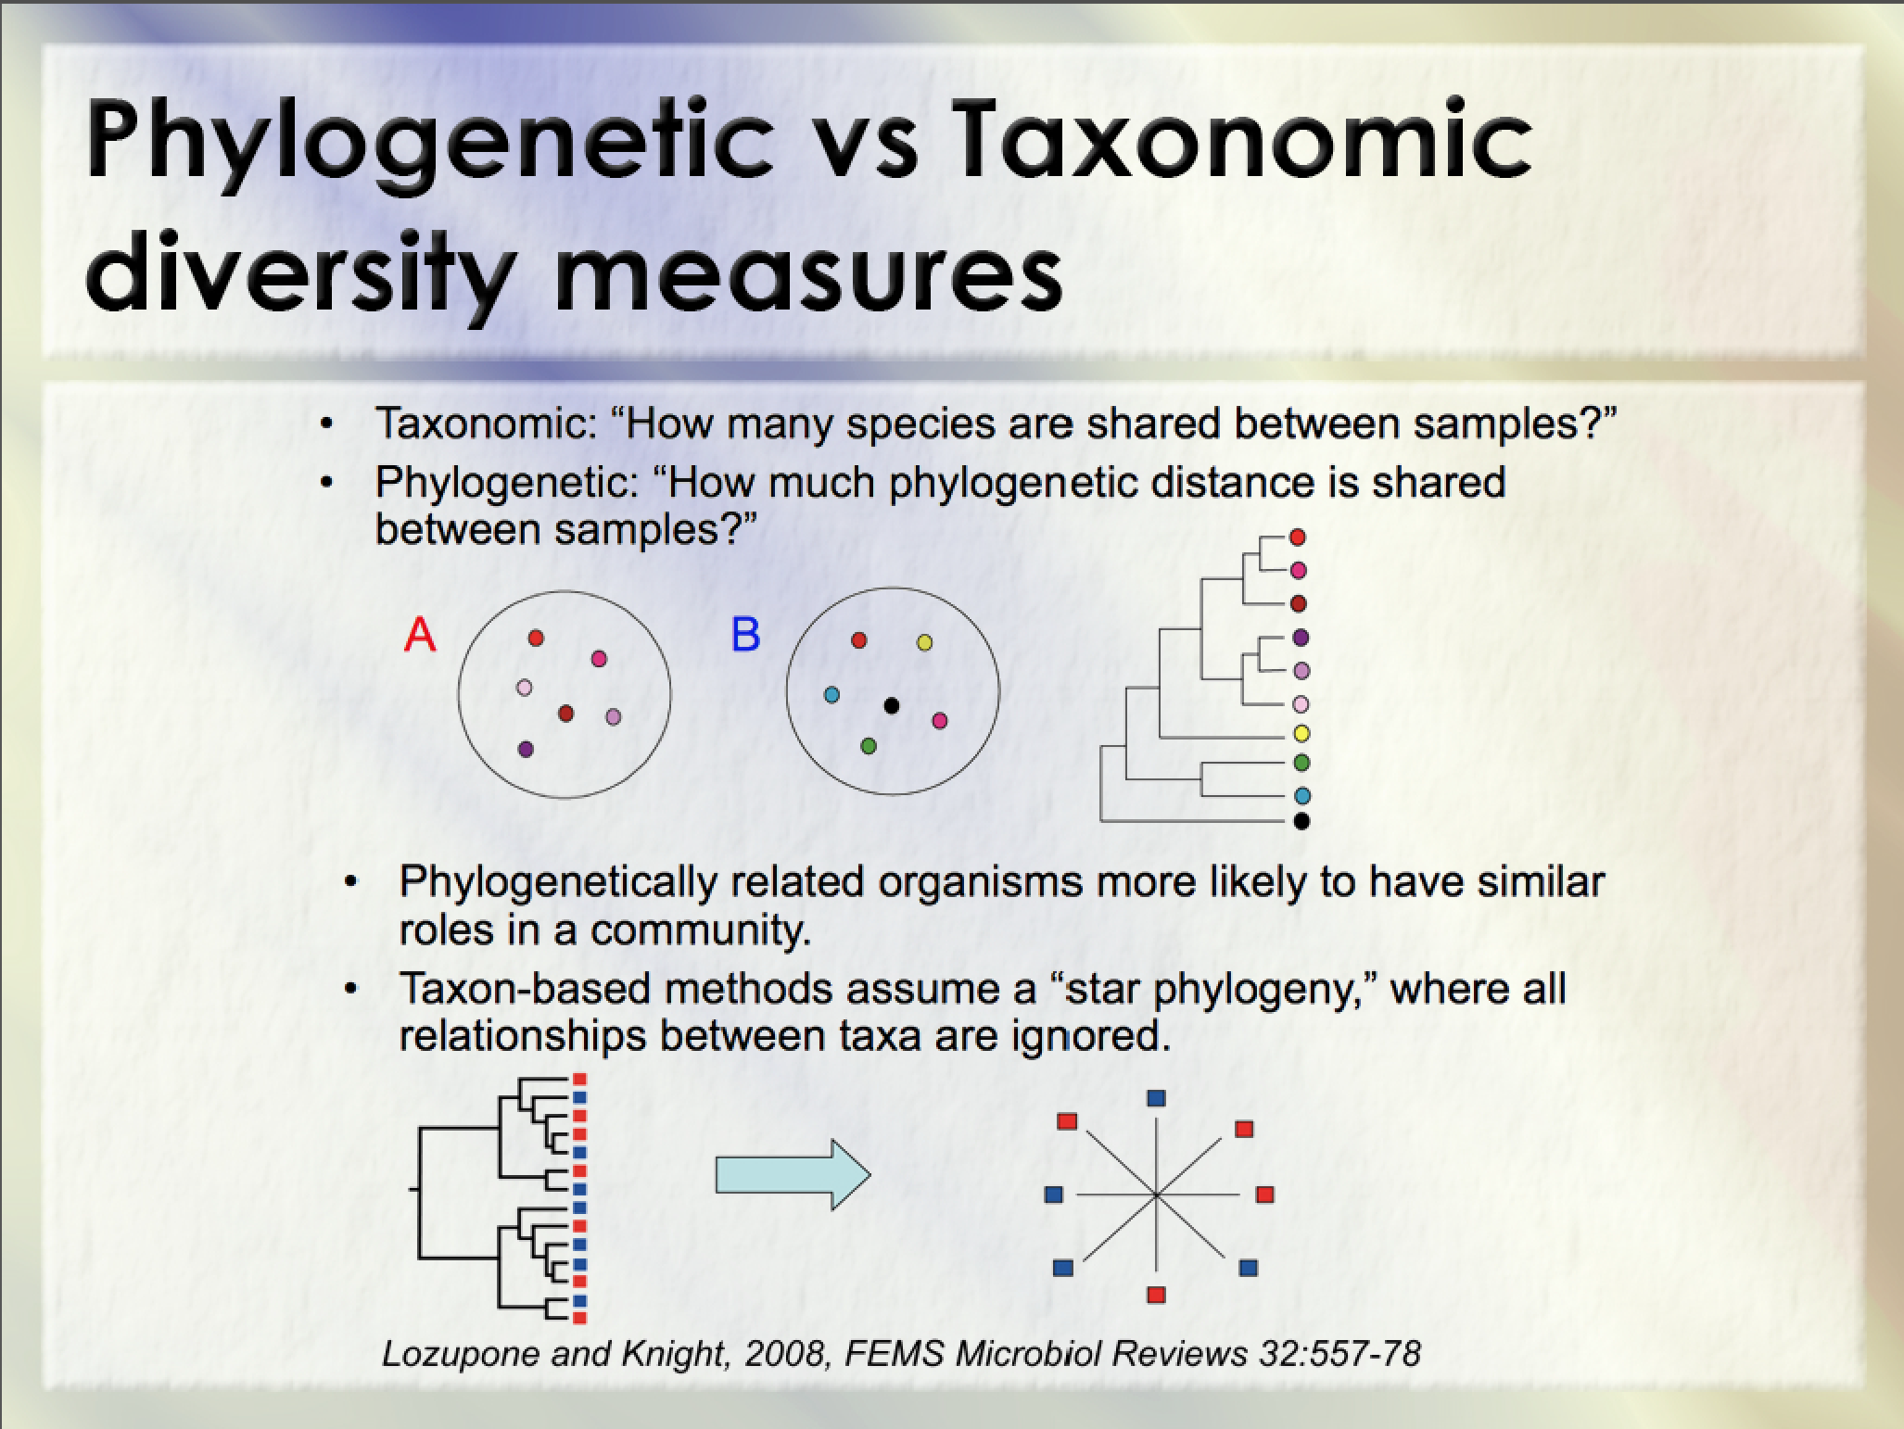

Slide 53
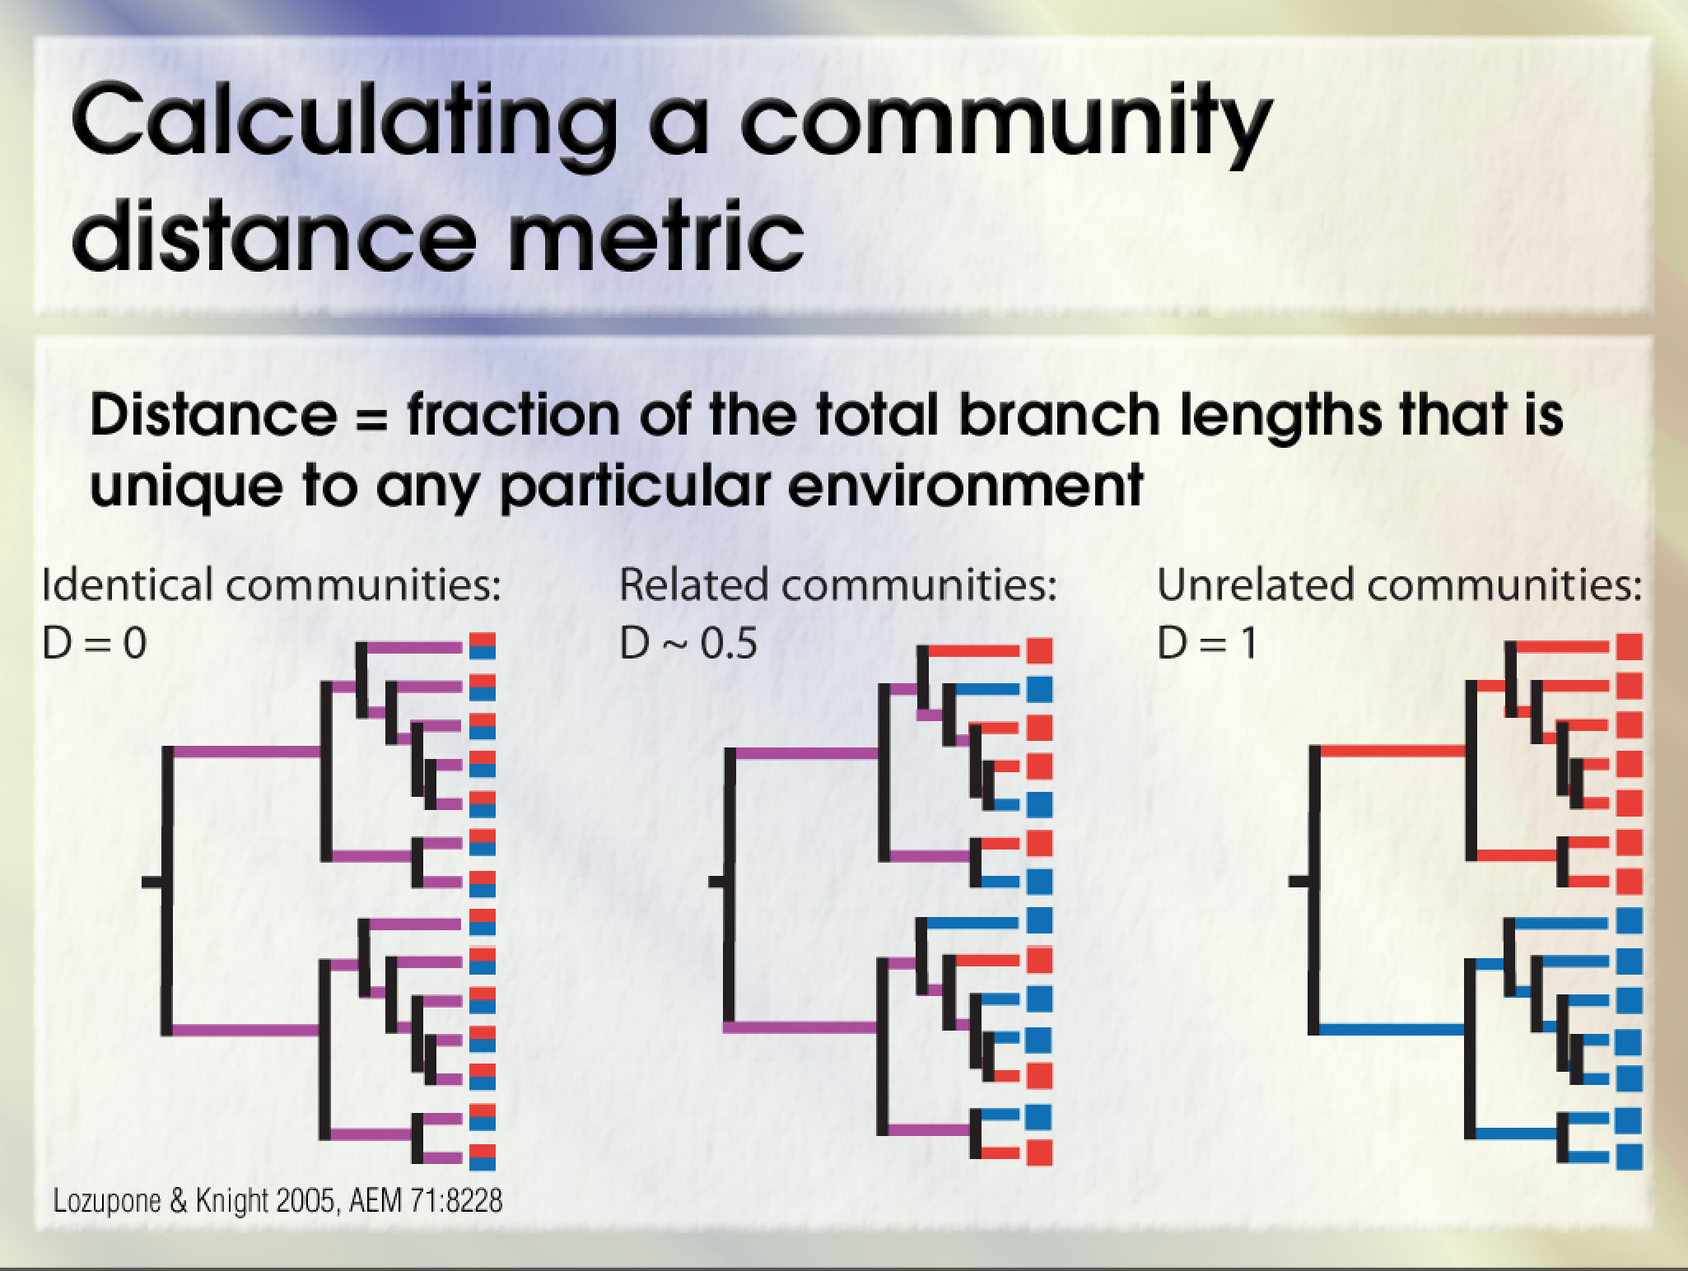

Slide 54
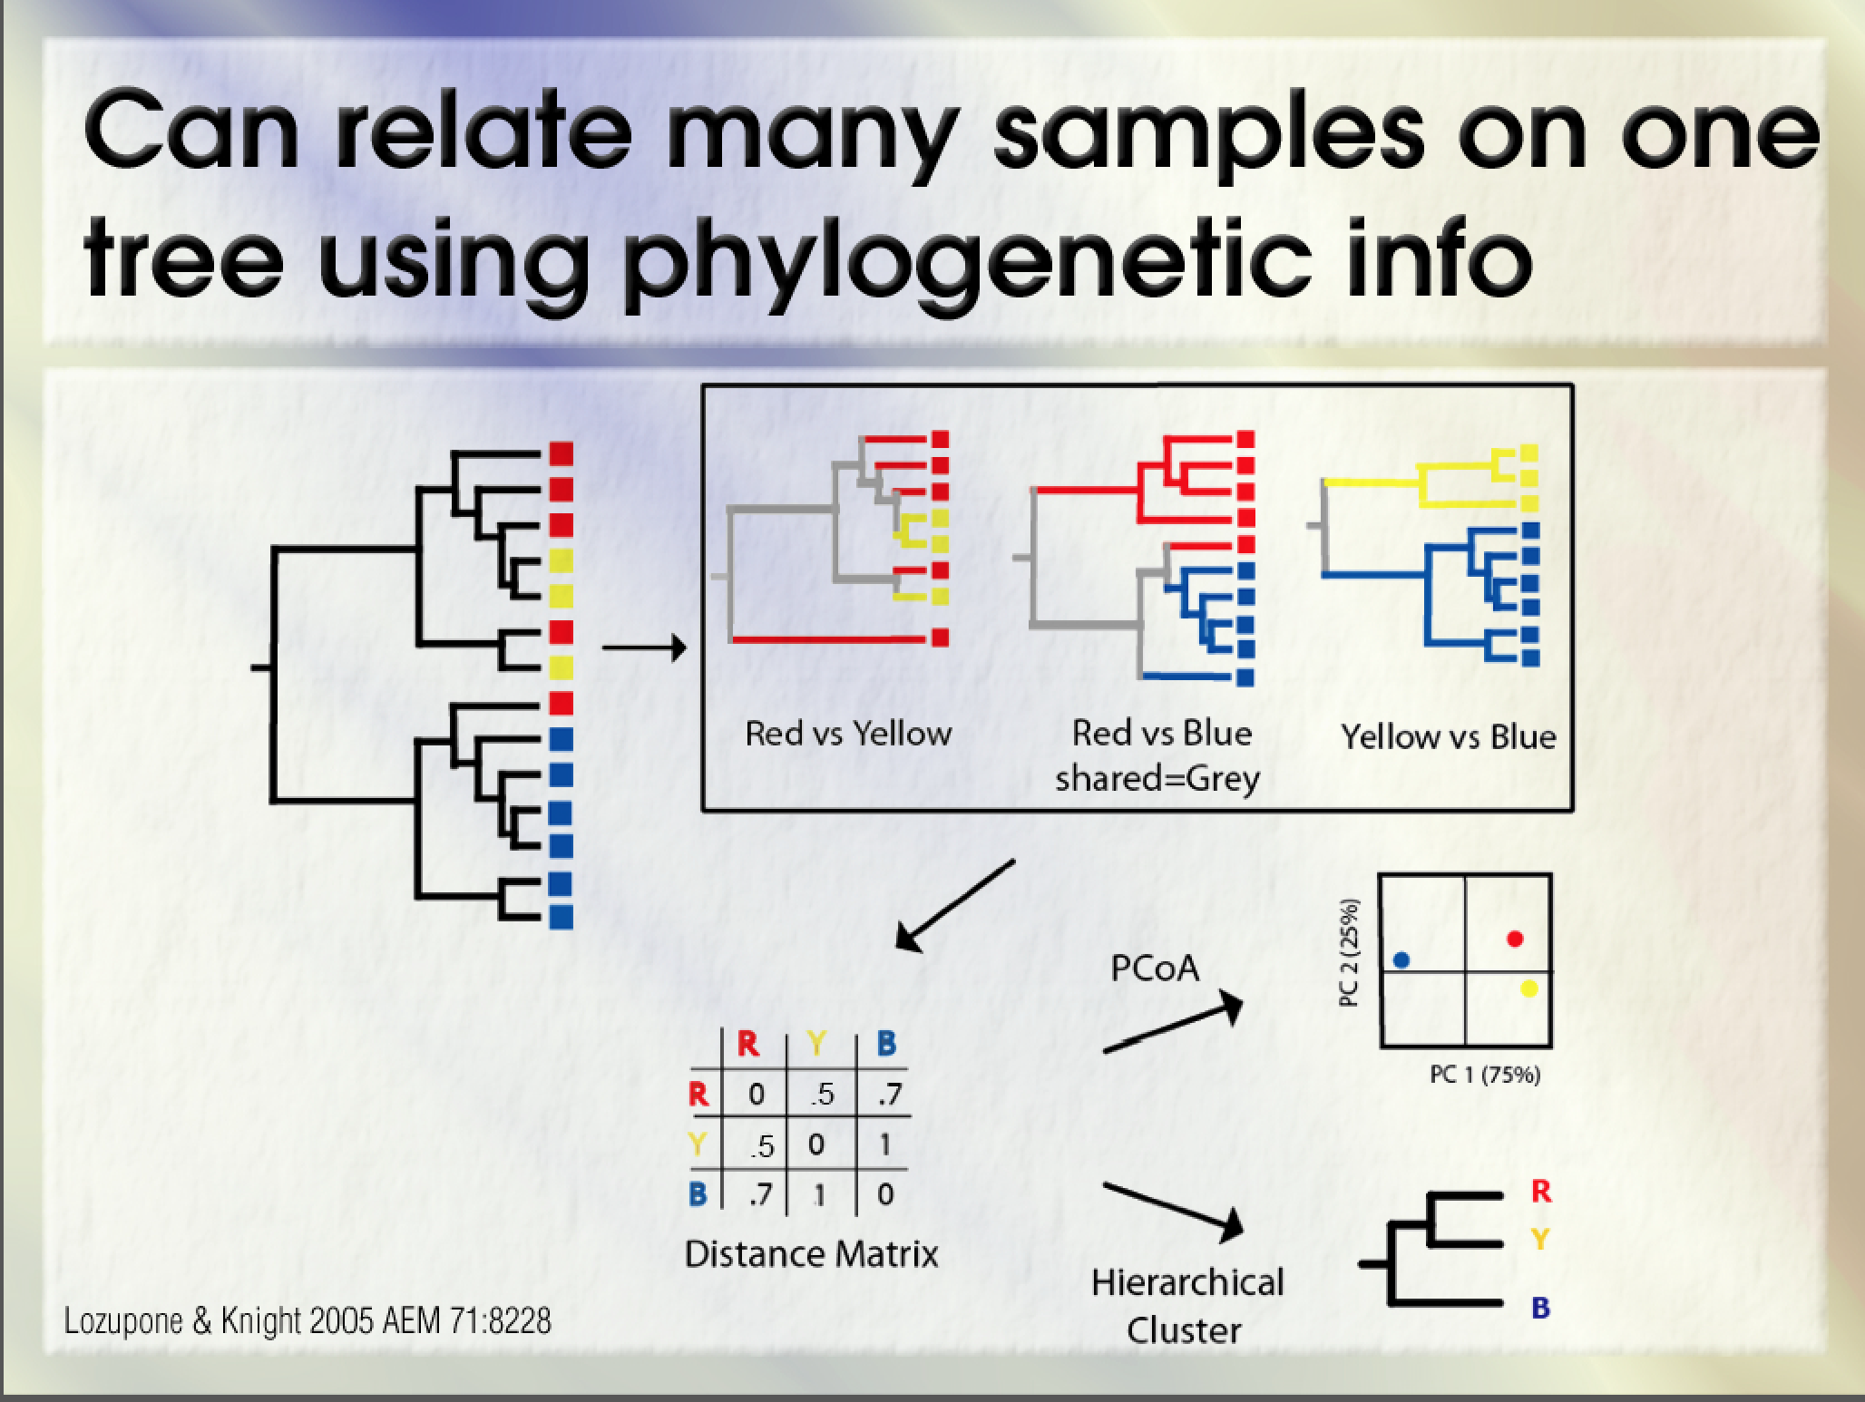

Slide 55
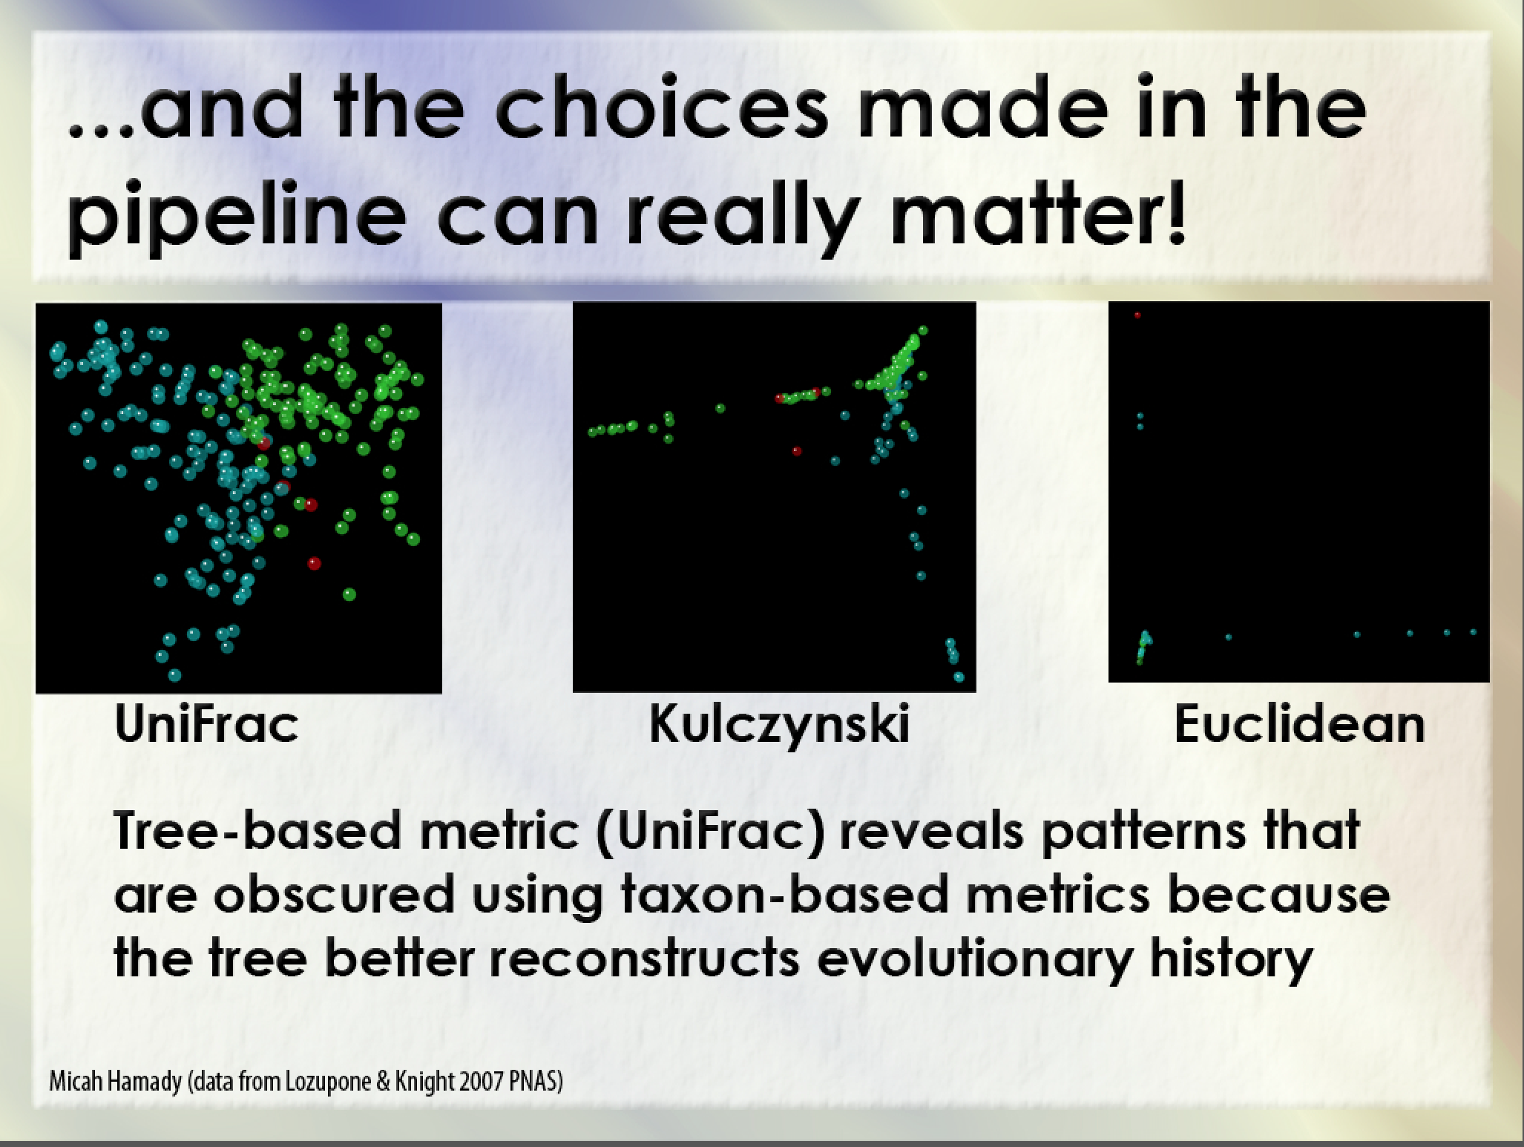

Slide 56
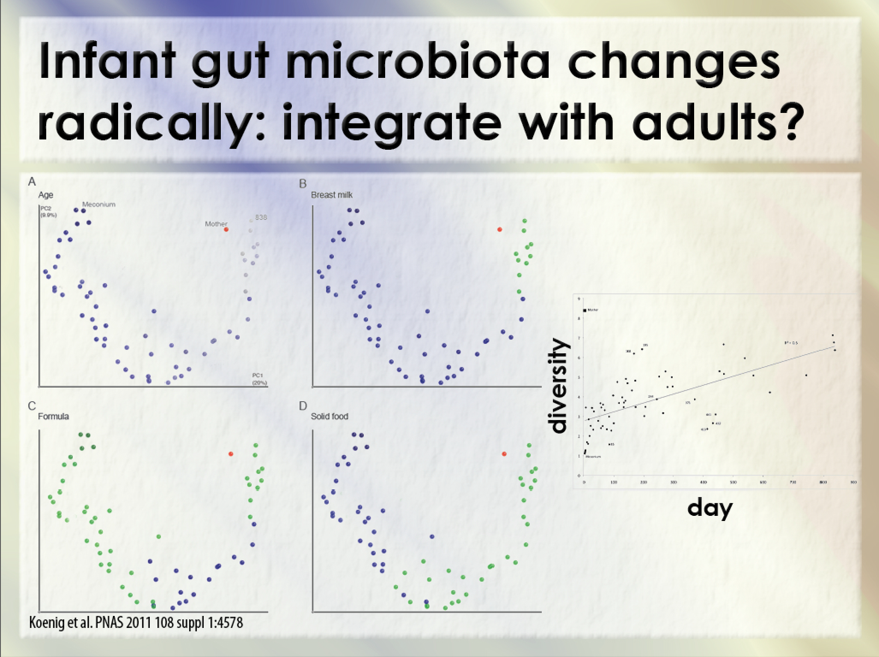

Slide 57
Glossary
Microbiome
Microorganisms and their habitat.
Microbiota
All the microorganisms within a habitat, synonymous with microbial community and microbial assemblage.
16S rRNA gene sequencing
A PCR based molecular method for determining which organisms are present in a DNA extract and how abundant they are. Metataxonomics and metagenetics proposed as term.
Metagenomics
The direct sequencing of a DNA extract, rather than a PCR product, distinct from 16S sequencing, but commonly confused.
Diversity
A summary statistic for community structure, commonly calculated from two components:
Species richness – the number of different types of organism present
Species evenness – the skew in relative abundance of these organisms (are they present at similar levels or is one more dominant)?

